Slide 1
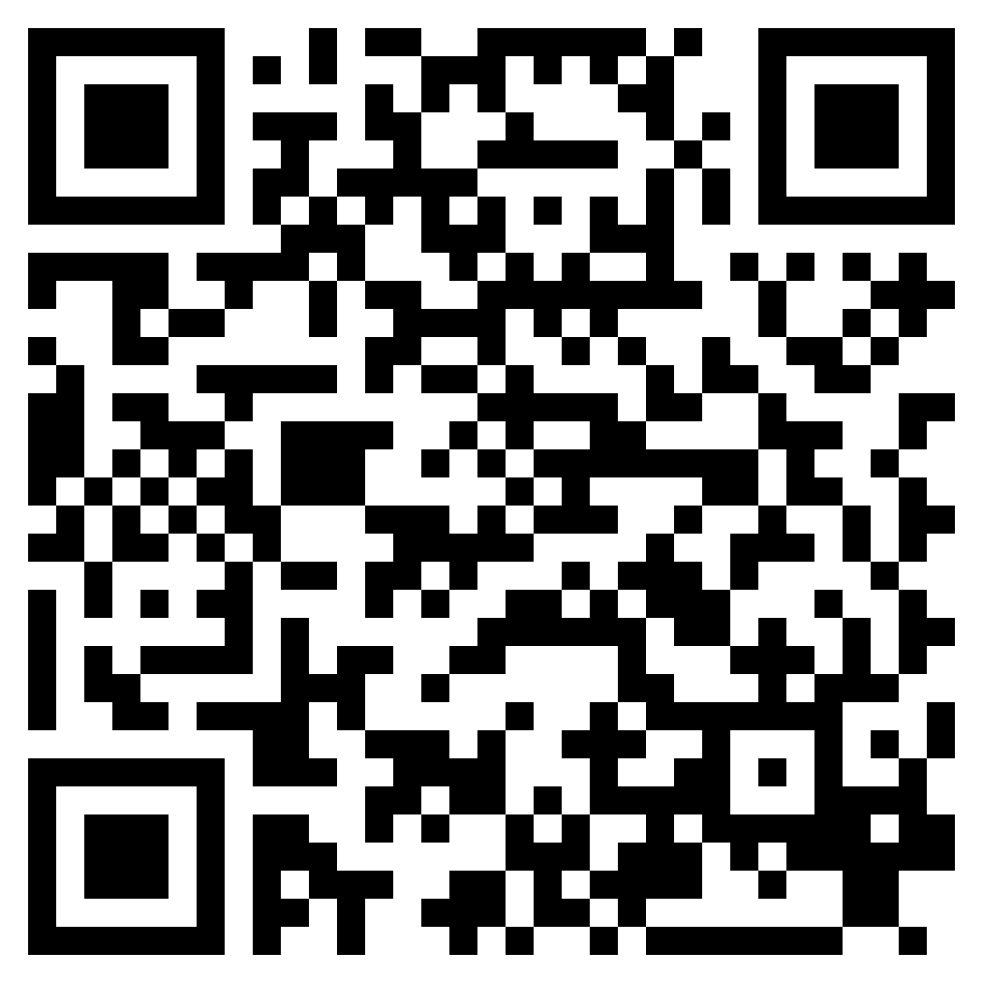
TURNING THE WORLD UPSIDE DOWN
ACTS 17

Slide 2
“And in the days of those kings the God of heaven will set up a kingdom that shall never be destroyed, nor shall the kingdom be left to another people. It shall break in pieces all these kingdoms and bring them to an end, and it shall stand forever,” (Daniel 2:44, ESV)

Slide 3
Psalm 2:1–3 (ESV)
¹ Why do the nations rage and the peoples plot in vain? ² The kings of the earth set themselves, and the rulers take counsel together, against the Lord and against his Anointed, saying, ³ “Let us burst their bonds apart and cast away their cords from us.”

Slide 4
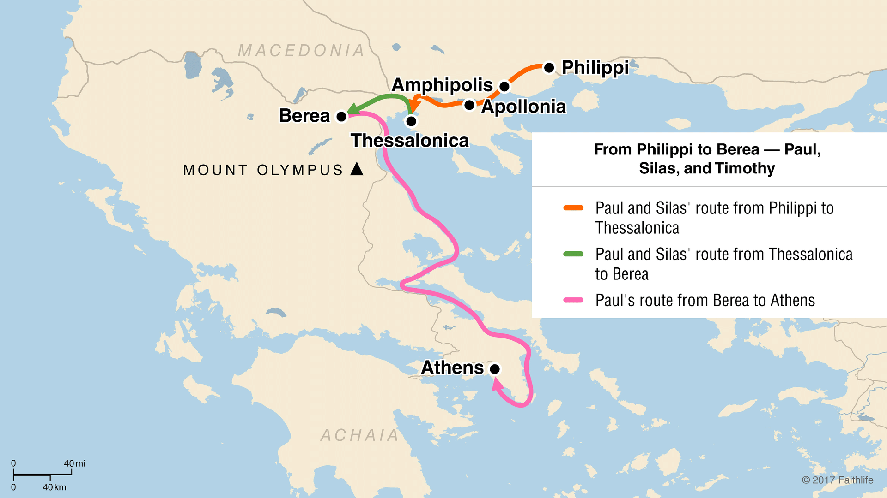

Slide 5
Acts 17:2–4 (ESV)
² And Paul went in, as was his custom, and on three Sabbath days he reasoned with them from the Scriptures, ³ explaining and proving that it was necessary for the Christ to suffer and to rise from the dead, and saying, “This Jesus, whom I proclaim to you, is the Christ.” ⁴ And some of them were persuaded and joined Paul and Silas, as did a great many of the devout Greeks and not a few of the leading women.

Slide 7
“Now these Jews were more noble than those in Thessalonica; they received the word with all eagerness, examining the Scriptures daily to see if these things were so.” (Acts 17:11, ESV)

Slide 9
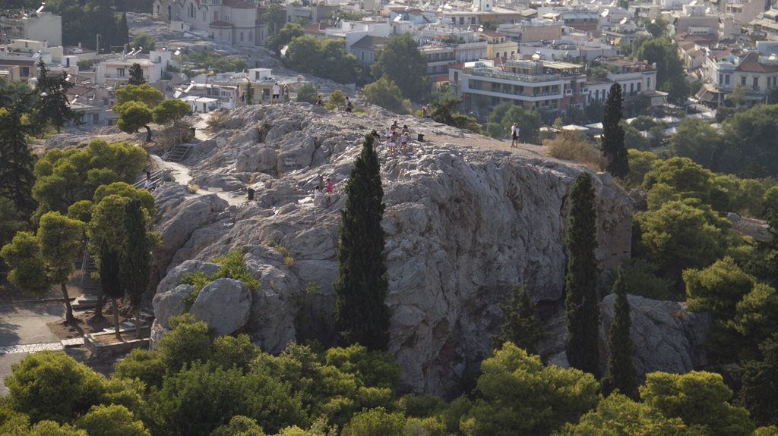

Slide 10
TURNING THE WORLD UPSIDE DOWN
ACTS 17

