Slide 1
Gossip

Slide 3
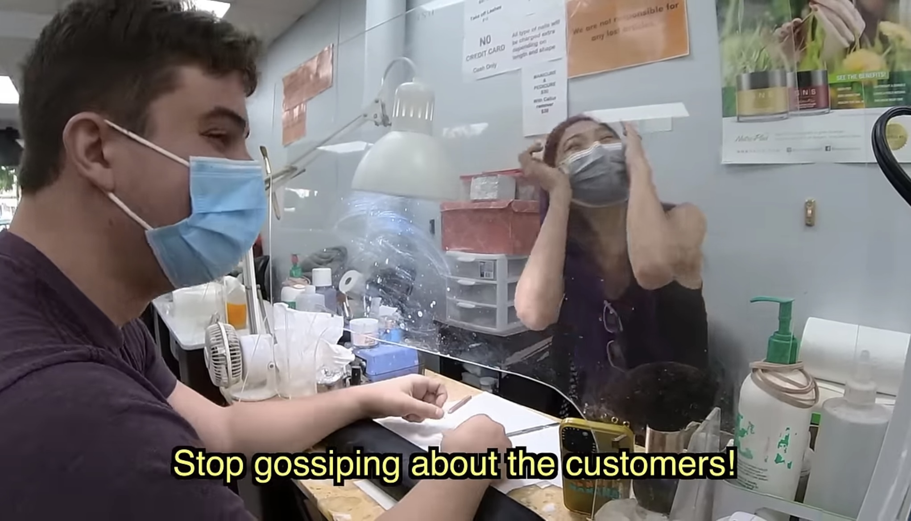

Slide 4
Gossip
Tattler- One who utters silly talk or nonsense, hence a prater or babbler.
Casual or unconstrained conversation or reports about other people, typically involving details that are not confirmed as being true.
Gossip is a big deal because it is a sin (Romans 1:29-32)!

Slide 5
Gossip harm others
Proverbs 16:28 CSB A contrary person spreads conflict, and a gossip separates close friends.
Talking about a situation with someone who is neither part of the problem nor the solution.
Not all gossip are complete lies but can still be harmful (Mark 14:55-62).

Slide 6
Gossip is not so Broad
Some believe talking about anyone, anytime, for any reason constitutes gossip.
1). Consider our intentions.
2). Consider the other person and how they feel about it.
3). Consider what is our gain from spreading that information.

Slide 7
Gossip will hinder your reward in Heaven
Reveals personal/confidential information.
Sees the bad in others, ignores the good.
Exaggerates statements, scenarios, situations.
Repeats all knowledge without discretion, Uses others to exact vengeance.
Everything you say is being recorded (Matthew 12:35-37)!

Slide 8
GOSSIP Extinguishers
Keep confidences (Proverbs 11:13).
Accentuate the positive (Philippians 4:8).
Speak accurately and with purity (Ephesians 4:15).
Avoid gossips (1 Corinthians 15:33).
Be prepared to respond constructively (John 8:7).
Have the humility to apologize (James 5:16).

