Slide 1
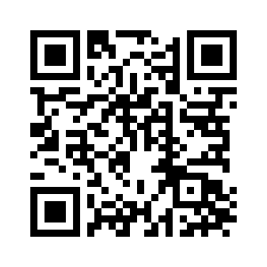
CHAPTER 12

Slide 2
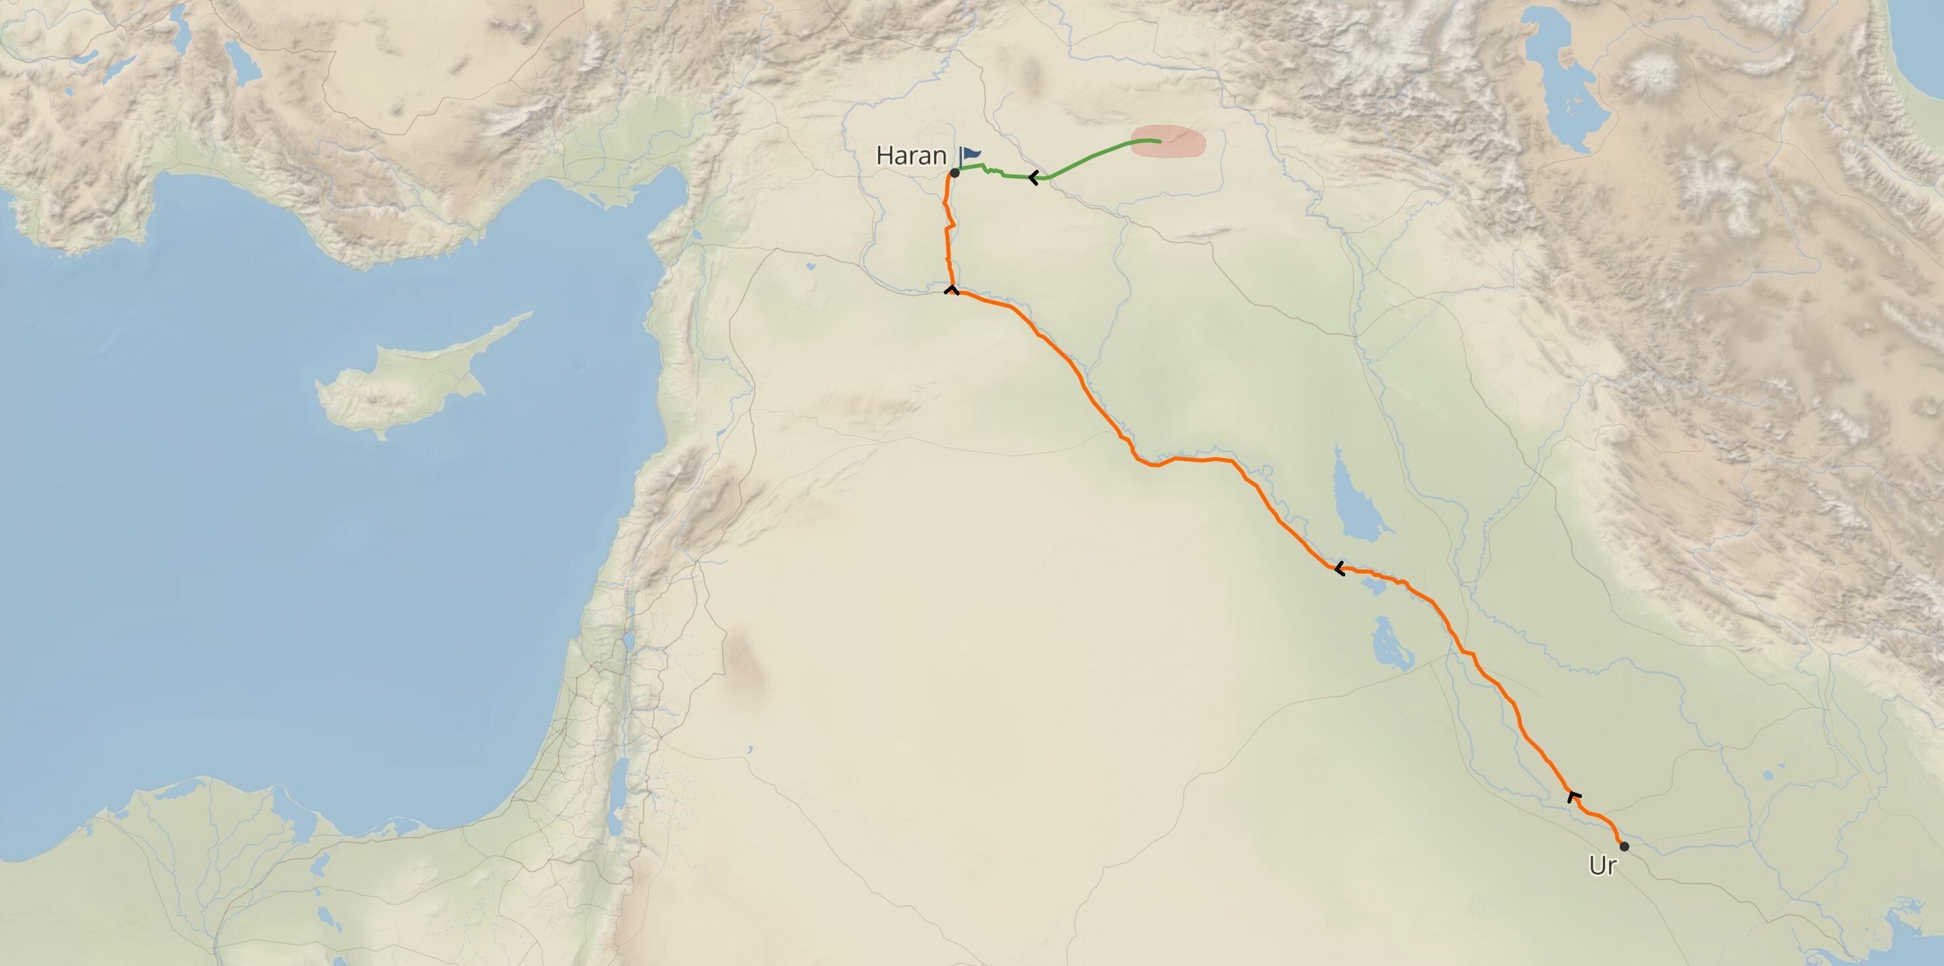
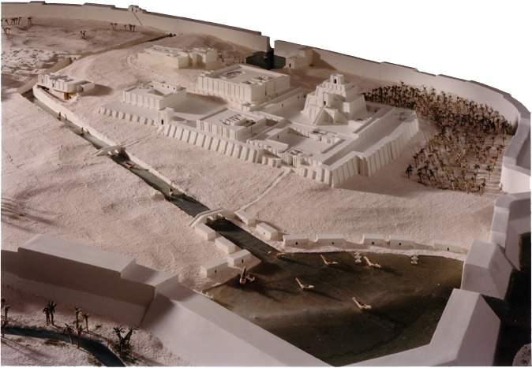
11.27-32, Family of Terah

Slide 3
12.1-3, Promises to Abram
Genesis 12:1–3 (ESV)
¹ Now the Lord said to Abram, “Go from your country and your kindred and your father’s house to the land that I will show you. ² And I will make of you a great nation, and I will bless you and make your name great, so that you will be a blessing. ³ I will bless those who bless you, and him who dishonors you I will curse, and in you all the families of the earth shall be blessed.”

Slide 4
12.1-3, Promises to Abram
His descendants would become a great nation (Exodus 1.7).
His descendants would inherit the land God showed to Abraham (vs. 7; Joshua 21.43).
Abraham’s offspring would indeed bless all families of the earth (Galatians 3.8,16).

Slide 5
12.1-3, Promises to Abram
Galatians 3:8 (ESV)
⁸ And the Scripture, foreseeing that God would justify the Gentiles by faith, preached the gospel beforehand to Abraham, saying, “In you shall all the nations be blessed.”

Slide 6
12.1-3, Promises to Abram
Galatians 3:26–29 (ESV)
²⁶ for in Christ Jesus you are all sons of God, through faith. ²⁷ For as many of you as were baptized into Christ have put on Christ. ²⁸ There is neither Jew nor Greek, there is neither slave nor free, there is no male and female, for you are all one in Christ Jesus. ²⁹ And if you are Christ’s, then you are Abraham’s offspring, heirs according to promise.

Slide 7
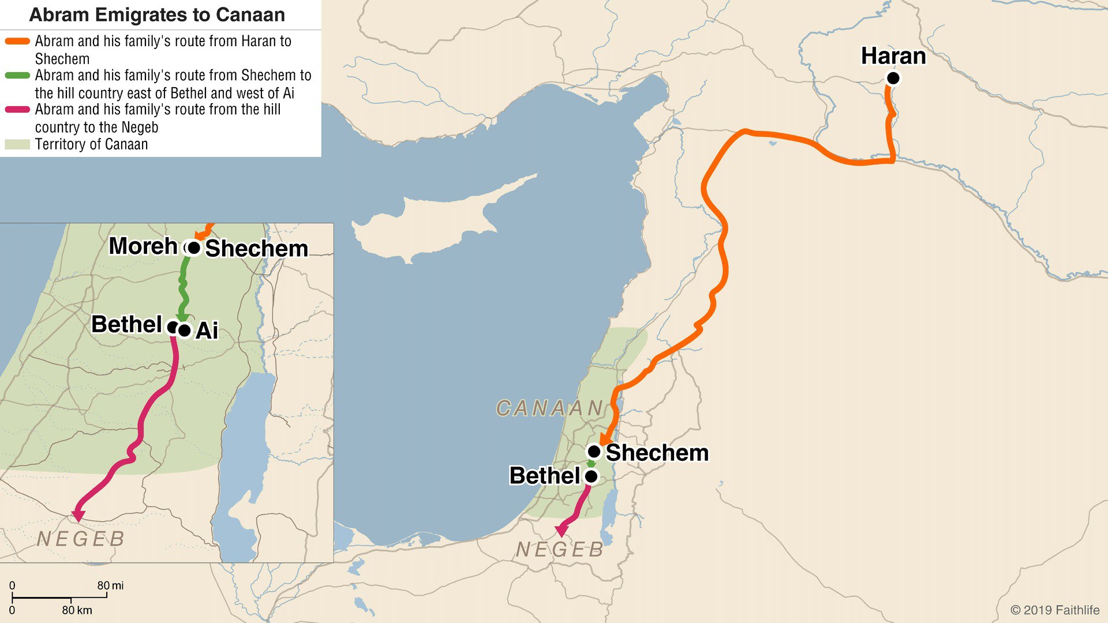
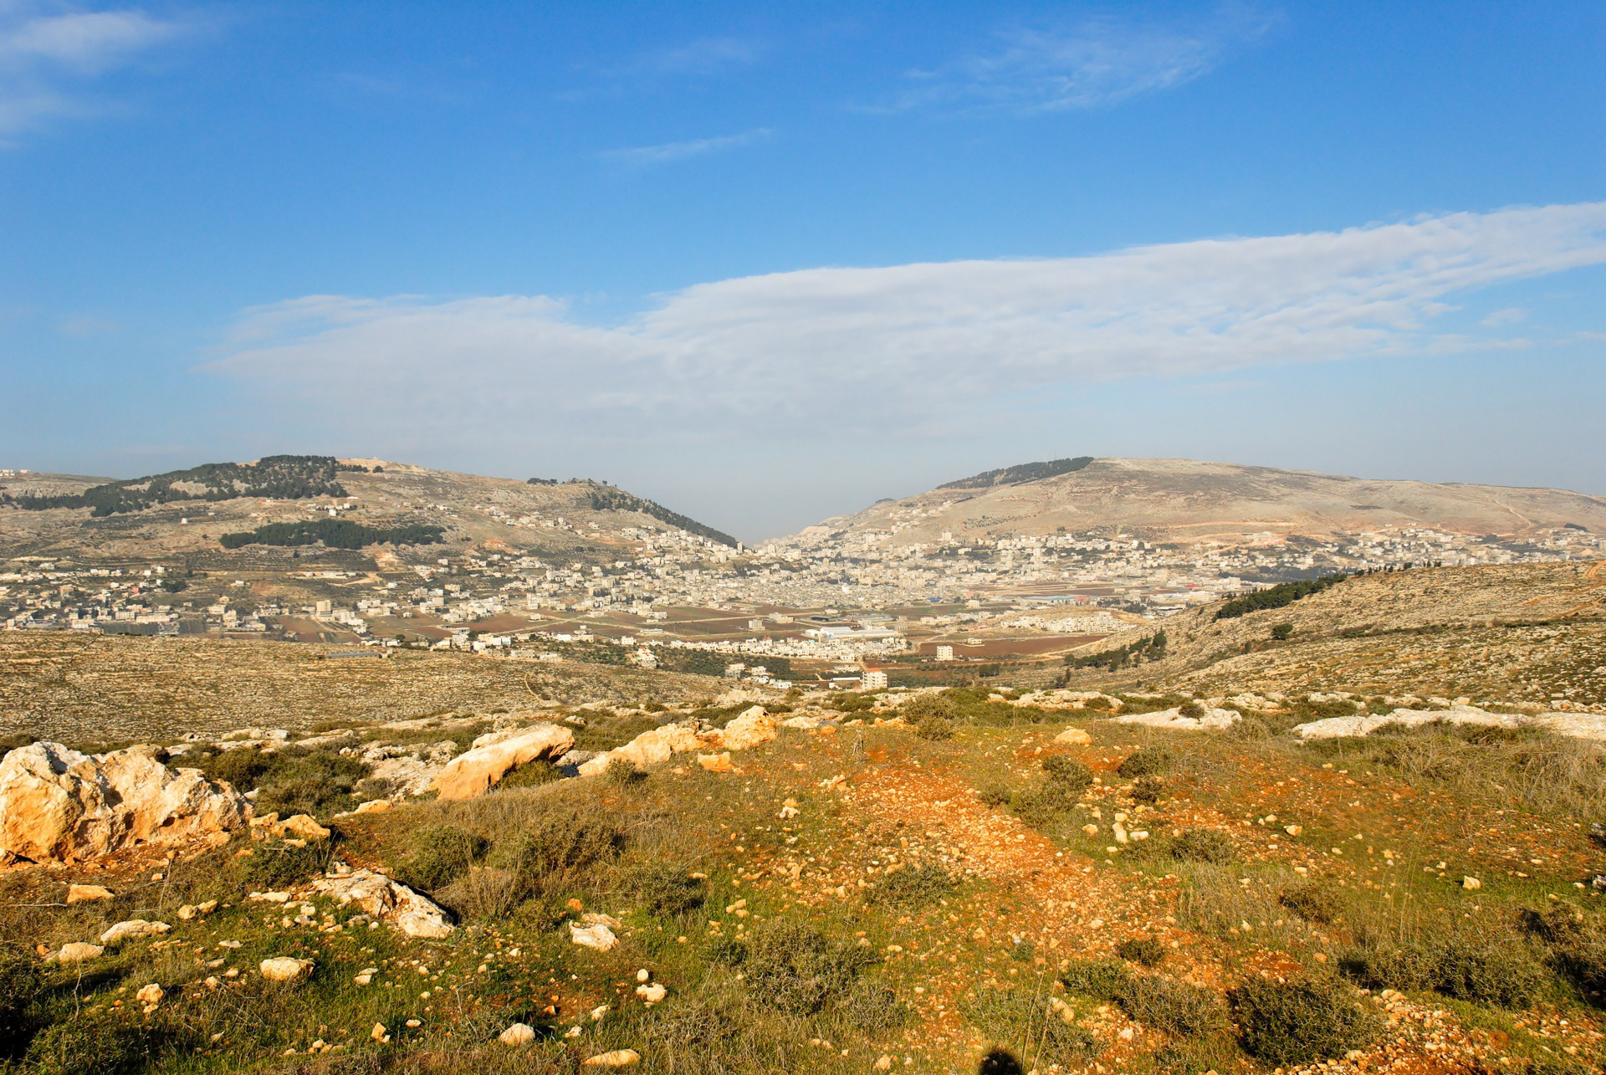
12.4-9, Journey to Canaan

Slide 8
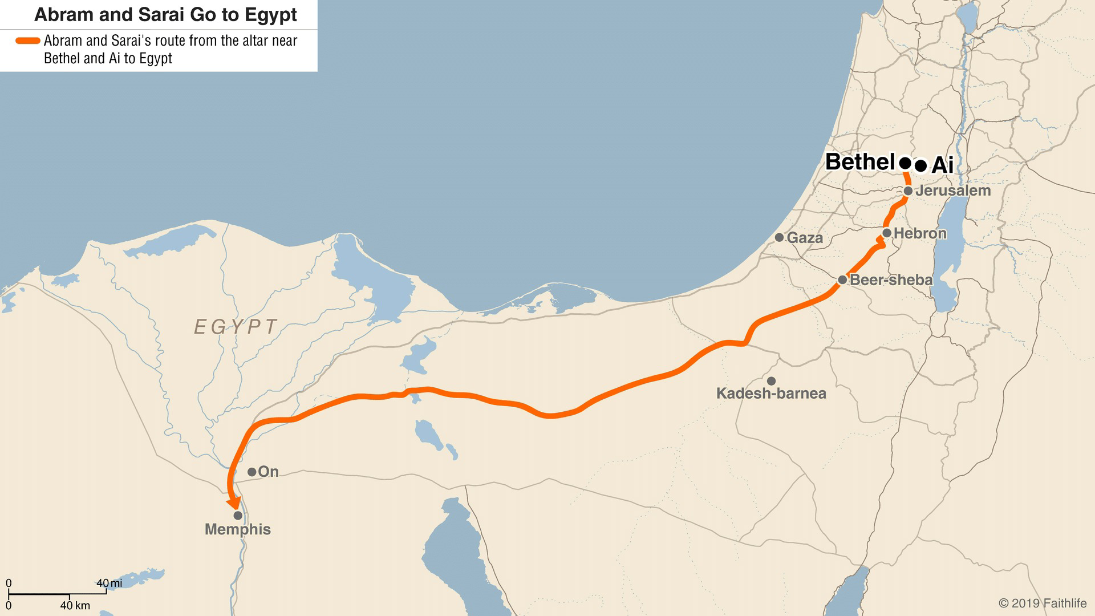
12.10-20, Faith Tested in Egypt

